Slide 1



FudgeFlix FudgeMart Cross-Division Data Warehouse IST 722 Group 1 Project Sales Integration
Matt Arsenault, James Alexander, Kaye Burnet, Stephen Omondi
March 22, 2020

Slide 2
Overview
Project Charter
Business Process
Star Schema
Summary
Power BI Visuals
Recomendations
Goals of Analytics

Slide 3

Project Charter
Objectives:
Create a data warehouse that facilitates corporate analysis across businesses
Conduct BI analysis of those businesses
Goal: Document the utilization of the principals and processes of data warehouse design
High Level Modelling Worksheet
Detailed Modeling Worksheet
ETL: Databased Implementation
Star Schema
MOLAP Cube
BI Analysis

Slide 4
Business Processes
Inventory Management
Current inventory, Reorder levels and Triggers
Potential optimization, plan and adjust for changes in environment
Sales Management, Pricing & Billing
Sales by customer, department, employee, location, timeframe
Optimization, reorganization, incentives, product life cycles, trends
Customer Satisfaction and Problem Identification
Ratings by region, product, employee
KPI tracking, improve processes, customer service, optimize product lines
Income Tracking: Accounts receivable, Income
Invoices, income, debts,
KPIs, revenue, by region, employee, business
Shipping, Fulfillment & Invoicing
Orders, shippers, shipping date, invoices, receivables
KPIs of shipping time, billing and receiving, shipping costs

Slide 5

GAnadfasdfkoals of Analytics
Analytics Goals
Unit Metrics: Volume and Revenue
Identify Product Loss Leaders
Product Discrimination, Expansion
Sales Opportunities Through Product Bundling
Specific questions:
What products sell the best? What products are harder to sell?
What is the highest revenue product and the lowest revenue product categories?
Are we selling discontinued products? Do we have discontinued products that we need to sell?
Regional Questions: What region is our highest performing? DO we have regions where we are under-performing? Are there places where we can expand sales?

Slide 6
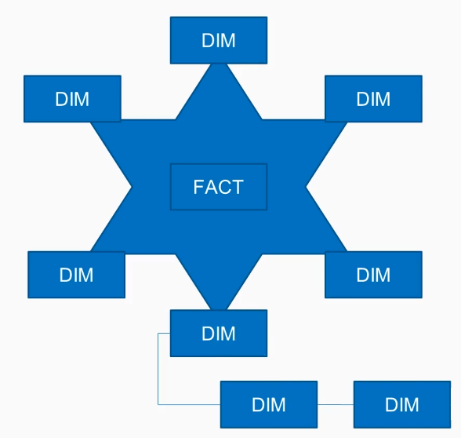
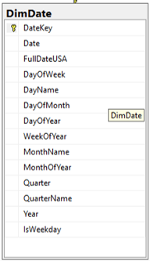
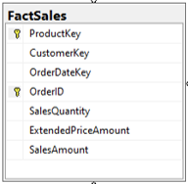
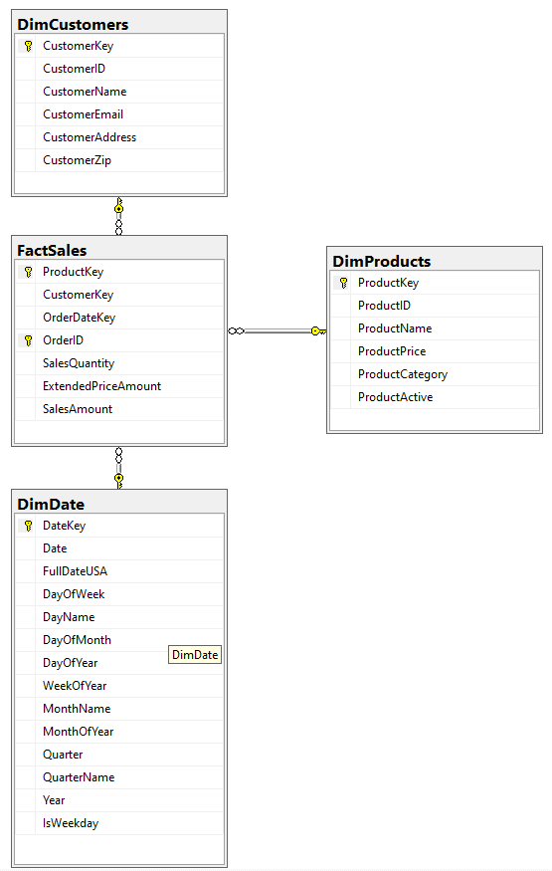
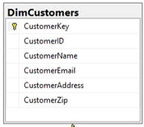
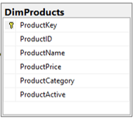
Star Schema

Slide 7
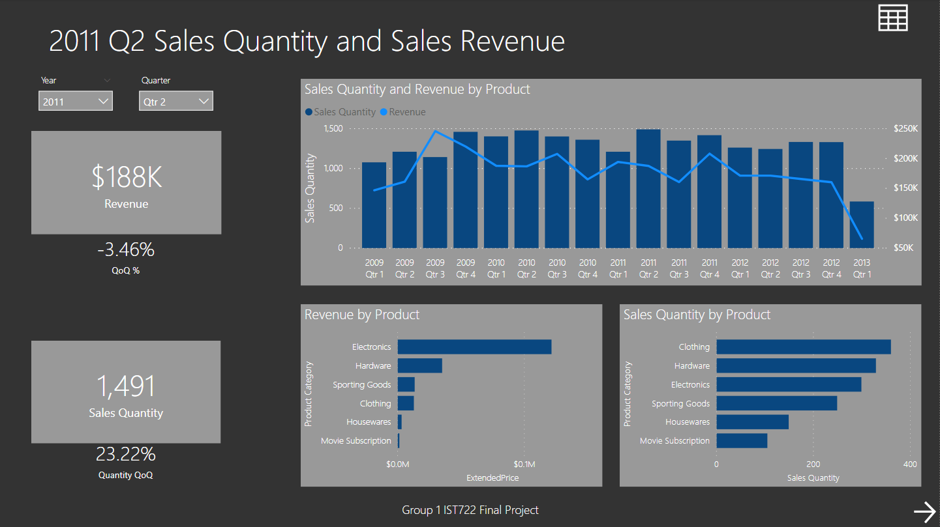
Power BI Snapshots: Note Qtr 1 2013 Incomplete

Slide 8
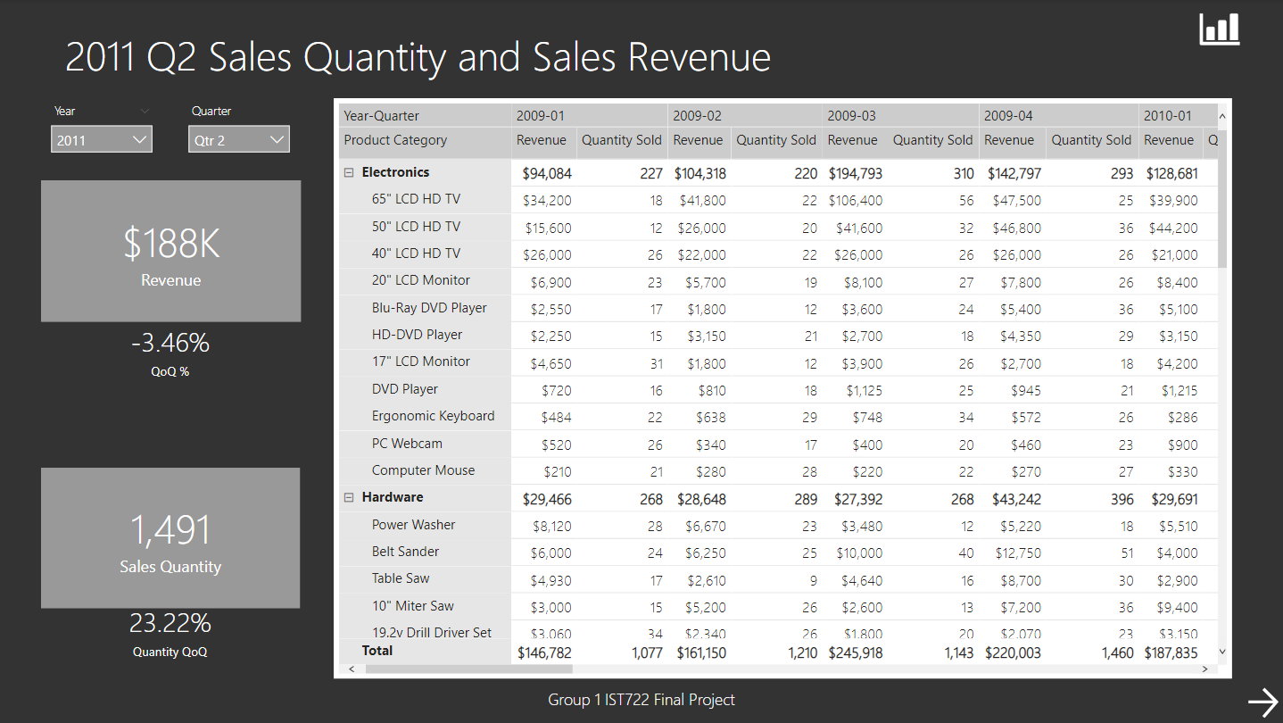
Power BI Snapshots:

Slide 9
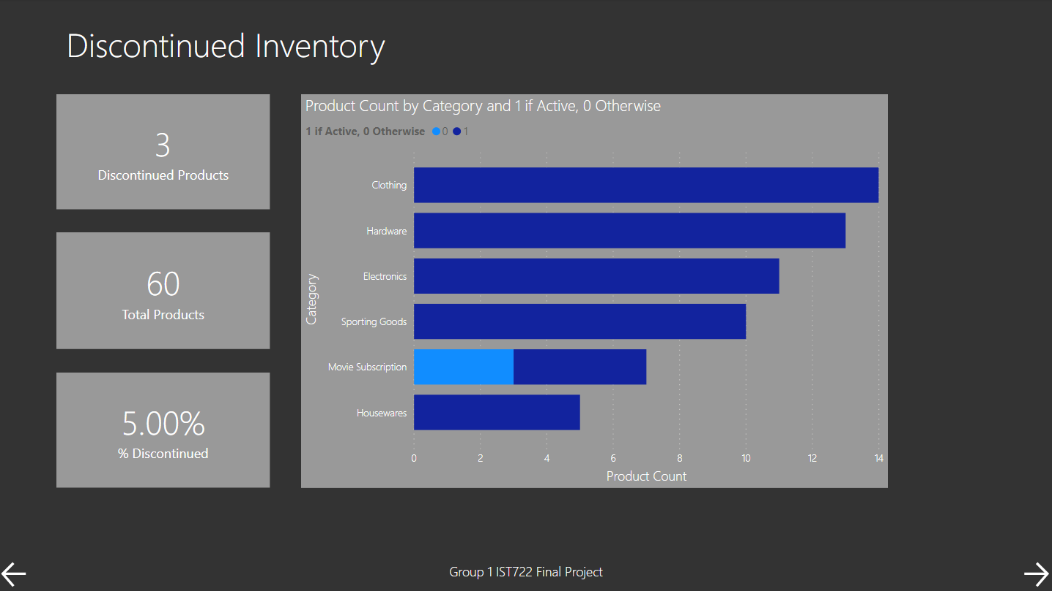
Power BI Snapshots:

Slide 10
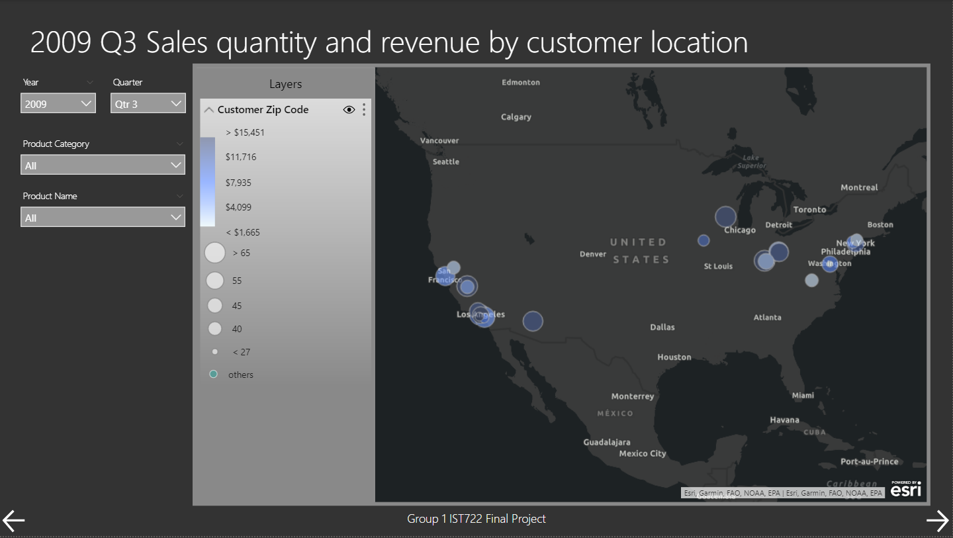
Power BI Snapshots:

Slide 11
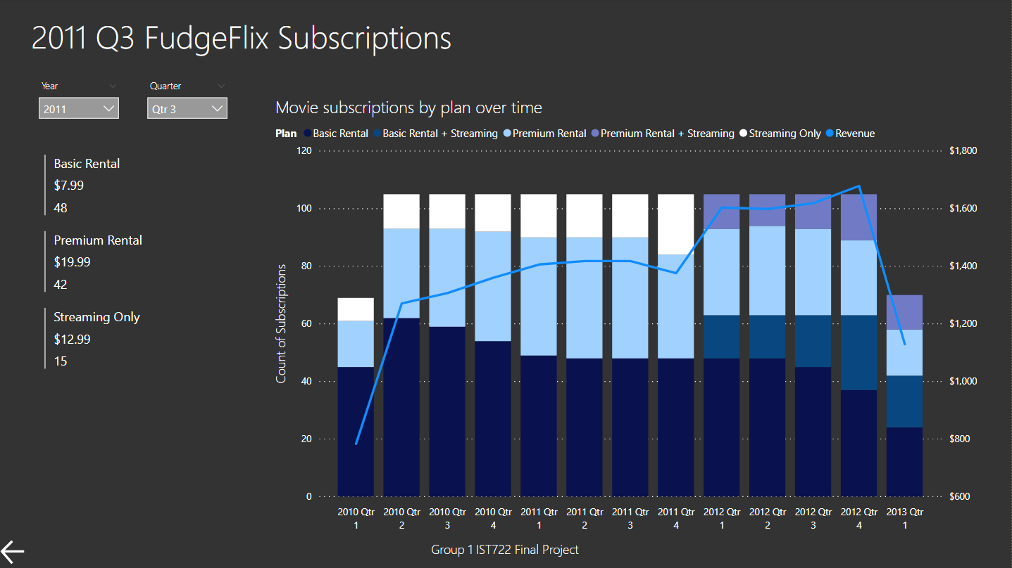
Power BI Snapshots: Note Qtr 1 2013 Incomplete

Slide 12




Develop a Middle America Strategy
Double down on electronics given the higher reveneue per item
Home office combinations
Data: More would be nice
Leverage trends such as a surge in TV sales as technology changes.
Bundle products. A pilot program for FudgeMart
A year free of FudgeFlix service with TV purchase
National marketing beyound largest markets
Summary
Geography:
Low adoption in middle America
It may be time to consider national marketing and look at the payoff of expanding beyond the largest markets
High-priced items:
The revenue increase in Q3 2009 was driven by shift in products composition
We sold more LCD HD TVs in that quarter
Clothing is a top sales product, but it is lower revenue per item
New Initiatives:
Premium rental plan for FudgeFlix in Q1 2012
Self-selected high-priced category
Bundling the rental and streaming services was successful

Slide 13
Questions?

